Slide 1

R Programming Concepts
Sep 13-14, 2023
You should have R & RStudio installed
https://sites.northwestern.edu/researchcomputing/resources/r-and-rstudio/
Download materials from:
https://github.com/nuitrcs/R-programming-concepts-Chicago-2023

Slide 2
Research Computing and Data Services
Ritika Giri
Christina Maimone
Efrén Cruz Cortés
We're here to help after the workshops!
bit.ly/rcdsconsult

Slide 3
BYOD
BYOD = Bring Your Own Data
Small working groups, meet weekly
https://sites.northwestern.edu/researchcomputing/events-and-programs/byod/

Slide 4
What are we doing today?
Getting to know R and RStudio
Learning concepts that you need for R (that also apply to other programming languages)

Slide 5
What are we doing?
Topics
R / Rstudio
File paths
Working directory
R scripts and Documents
Functions
Variables
Packages
Importing data
Data frames
Indexing data frames and vectors
Subsetting data
Missing values

Slide 6

Terminology
Programming Languages, Consoles, and GUIs

Slide 7
GUIs
GUI: Graphical User Interface: Programs on your computer with buttons and other visual elements; you can interact with a mouse or touchscreen
Powerpoint, Word, SPSS, Zoom, internet browser, etc.

Slide 8
Problem: How do we tell others what we did? How do we keep track of what we did for ourselves?

Slide 9
Programming Languages
A system for giving instructions to a computer (writing code)
Specific words and characters in a specific order

Slide 10
Programming Languages
A system for giving instructions to a computer (writing code)
Specific words and characters in a specific order
You give these instructions to an interpreter or compiler which translates them into something your specific computer can use
Interpreters (R and Python): Give an instruction, get a result – directly executes the instructions
Compilers (C++, Java): Write an entire program, then translate the entire program into computer-level instructions, and then run that program

Slide 11
Console/Terminal/Shell/Command Line Interface
Simple computer program where we type commands, one line at a time (hence: command line)
They can run different interpreters: bash, zsh, PowerShell (Windows), R, Python
Type instructions at a prompt (> or $ or % or >>> or : or others)
Used for basic operations and running other programs

Slide 12
Console/Terminal/Shell
Mac:
Applications > Terminal
In RStudio, "Terminal" tab (we'll see this later)
Language-specific consoles (like R)
Windows:
Windows Console or Command Prompt (Start button, search for cmd)
PowerShell
Language-specific consoles (like R)

Slide 13
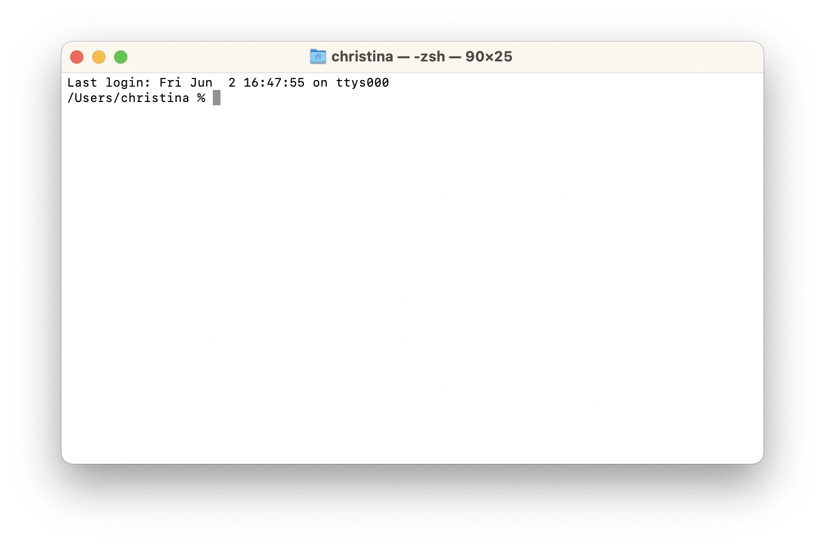

Slide 14
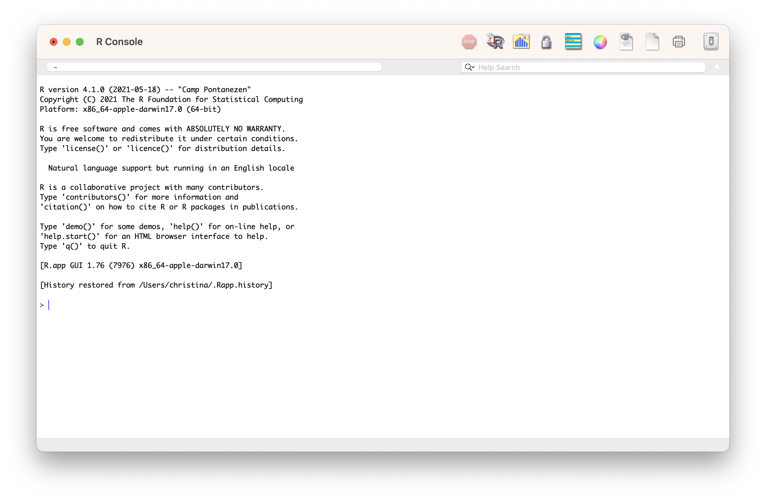

Slide 15
But that’s sometimes annoying and inconvenient… and how do we record what we did?

Slide 16
IDEs
IDE: Integrated Development Environment (e.g. RStudio): A GUI that helps make writing computer programs easier and interfaces with an interpreter or compiler
Usually includes:
File explorer
Area for writing code/scripts
Console for running interpreted languages
General terminal window for your system

Slide 17


Slide 18
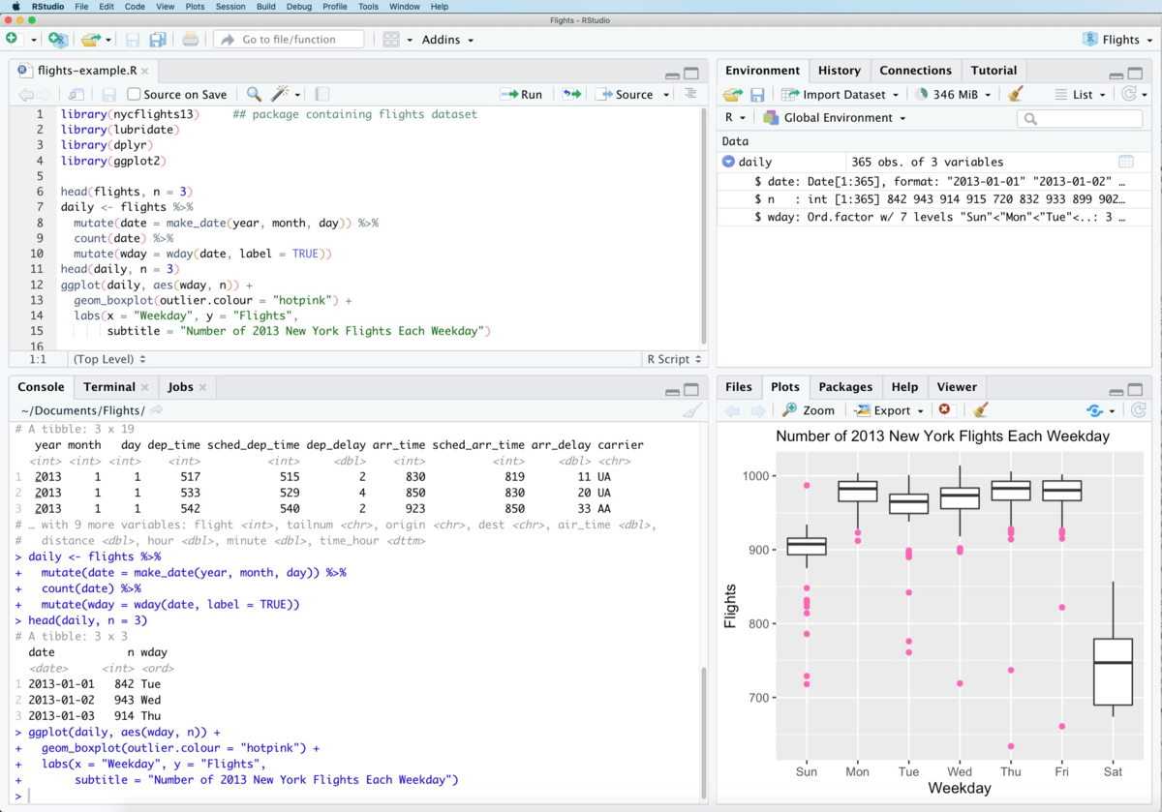
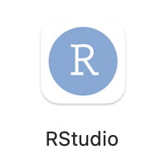

Slide 19
Everything that is an R command still has to run through the R interpreter (in the R console in RStudio)
Some buttons and menus write R code for us…

Slide 20

Yay!
We can keep a full record of everything we do!
Don’t have to write down instructions like:
open this menu, pick this option, check the third button, etc.
where the steps might vary with software version, operating system, etc
Means we can do reproducible science and research
Does not mean that this happens automatically!

Slide 21
Interpreted Programming Languages
Interactive programming: Interact with the interpreter via a console or terminal at the command line; execute one command at a time
> For reproducible research, still want keep a record of what you do
Batch programming: Write a script with multiple instructions that can be re-run in order
> You are writing a reproducible record (but still need to pay attention to things like your data files)

Slide 22
Which of these are true?
A: RStudio is a programming language
B: R and RStudio are the same program
C: RStudio is an IDE
D: RStudio is a GUI
E: R automatically makes our code reproducible
F: All R commands have to run through the R console/interpreter

Slide 23
Open RStudio
Type some math equations in the console and get answers
> Press enter at the end of a line to run the command
Open the file script1.R in RStudio
File menu > Open File…
or
Navigate to the file in the bottom right Files window in RStudio and click on the file to open it

Slide 24
Data Types & Boolean Operators
Head back to RStudio...

Slide 25
Which of these are true?
A: "\n" is an empty string
B: (TRUE & FALSE) | (FALSE | TRUE)
C: TRUE == 1
D: “Dog” == “dog”
E: "this is a valid character data'
F: The value false can be represented as: FALSE, F, or false

Slide 26
Variables

Slide 27

Variables
3

Slide 28
Variables
“dog”

Slide 29
Variables
TRUE

Slide 30
Variables
x

Slide 31
Variables
x
TRUE

Slide 32
Variables
x = 3
x <- 3
Variable name
"Left hand side"
Assignment
operator
Value
"Right hand side"

Slide 33
Variables
x <- 3
<- is preferred in R

Slide 34
Variables
x <- 3 + 5
x
x is 8

Slide 35
Variables
x <- 3
x + 5
x
x is 3

Slide 36
Variables
x <- 3
x <- x + 5
x
x is 8

Slide 37
Variables
x <- 3
y <- 5
x <- x + y
x
x is 8

Slide 38
Variables
x <- 3
y <- 5
x <- x + y
y <- 7
x
x is 8

Slide 39
Vectors and Lists

Slide 40
Storing Multiple Values Together
We combine them with c() into a vector
x <- c(2, 4, 7, 8)
Vectors may be called arrays or lists in other languages

Slide 41
Variables
c(2, 4, 7, 8)
x

Slide 42
Index the Values in a Vector
1 2 3 4
Indices in R start with 1
x <- c(2, 4, 7, 8)

Slide 43
Index the Values in a Vector
Indices in R start with 1
x <- c(2, 4, 7, 8)
x[1] is 2
x[2] is 4
Index goes inside
[]
x is the name of the variable with a vector

Slide 44
Changing values in a vector
x <- c(2, 4, 7, 8)
x[2] <- 6
x
2, 6, 7, 8

Slide 45
Changing a variable
x <- c(2, 4, 7, 8)
x <- 6
x
6
R doesn’t care what’s in the variable “bag”!

Slide 46

Back to RStudio…

Slide 47
Functions

Slide 48
Functions
Units of code
Take input values (arguments)
Can return an output value (e.g. a return value)
R functions usually don't alter their input values (but they sometimes do!)

Slide 49
Function Definitions
read.csv(file, header = TRUE, sep = ",", quote = "\"",
dec = ".", fill = TRUE, comment.char = "", ...)

Slide 50
Function Definitions: Function Name
read.csv(file, header = TRUE, sep = ",", quote = "\"",
dec = ".", fill = TRUE, comment.char = "", ...)

Slide 51
Function Definitions: Parameters
read.csv(file, header = TRUE, sep = ",", quote = "\"",
dec = ".", fill = TRUE, comment.char = "", ...)

Slide 52
Function Definitions: Parameter Names
read.csv(file, header = TRUE, sep = ",", quote = "\"",
dec = ".", fill = TRUE, comment.char = "", ...)
Notes:
Variables that exist inside the function -- can have the same name as your variables -- it's OK

Slide 53
Function Definitions: Default Values
read.csv(file, header = TRUE, sep = ",", quote = "\"",
dec = ".", fill = TRUE, comment.char = "", ...)

Slide 54
Function Definitions: Required Parameters
read.csv(file, header = TRUE, sep = ",", quote = "\"",
dec = ".", fill = TRUE, comment.char = "", ...)

Slide 55
Function Definitions: Additional Undefined Parameters
read.csv(file, header = TRUE, sep = ",", quote = "\"",
dec = ".", fill = TRUE, comment.char = "", ...)

Slide 56
Calling Functions: R: Named Arguments
read.csv(file, header = TRUE, sep = ",", quote = "\"",
dec = ".", fill = TRUE, comment.char = "", ...)
read.csv(file="results.txt",
header=TRUE,
sep="\t")
Notes:
In R, we call named arguments, keyword arguments.

Slide 57

Calling Functions: R: Named Arguments
read.csv(file, header = TRUE, sep = ",", quote = "\"",
dec = ".", fill = TRUE, comment.char = "", ...)
read.csv(sep="\t”,
file="results.txt”,
header=TRUE)
Notes:
In R, we call named arguments, keyword arguments.

Slide 58
Calling Functions: R: Positional Arguments
read.csv(file, header = TRUE, sep = ",", quote = "\"",
dec = ".", fill = TRUE, comment.char = "", ...)
read.csv("results.txt", TRUE, "\t")
Notes:
In R, we call named arguments, keyword arguments.

Slide 59
Calling Functions: R: Positional Arguments
read.csv(file, header = TRUE, sep = ",", quote = "\"",
dec = ".", fill = TRUE, comment.char = "", ...)
read.csv("results.txt", TRUE, "\t")
Notes:
In R, we call named arguments, keyword arguments.

Slide 60
Calling Functions: R: Positional and Named
read.csv(file, header = TRUE, sep = ",", quote = "\"",
dec = ".", fill = TRUE, comment.char = "", ...)
read.csv(file="results.txt", TRUE, "\t")
Notes:
In R, we call named arguments, keyword arguments.

Slide 61
Calling Functions: R: Positional and Named
1
2
read.csv(file, header = TRUE, sep = ",", quote = "\"",
dec = ".", fill = TRUE, comment.char = "", ...)
read.csv(file="results.txt", TRUE, "\t")
1
2
Notes:
In R, we call named arguments, keyword arguments.

Slide 62
Calling Functions: R: Positional and Named
1
2
read.csv(file, header = TRUE, sep = ",", quote = "\"",
dec = ".", fill = TRUE, comment.char = "", ...)
read.csv(header=TRUE, "results.txt", "\t")
1
2
Notes:
In R, we call named arguments, keyword arguments.

Slide 63
Calling Functions: R
read.csv(file, header = TRUE, sep = ",", quote = "\"",
dec = ".", fill = TRUE, comment.char = "", ...)
Notes:
In R, we call named arguments, keyword arguments.

Slide 64
Calling Functions: R: Which will work?
read.csv(file, header = TRUE, sep = ",", quote = "\"",
dec = ".", fill = TRUE, comment.char = "", ...)
read.csv("results.txt", sep="\t")
read.csv("results.txt", "\t")
read.csv("results.txt", TRUE, "\t")
Notes:
In R, we call named arguments, keyword arguments.

Slide 65
Calling Functions: R
read.csv(file, header = TRUE, sep = ",", quote = "\"",
dec = ".", fill = TRUE, comment.char = "", ...)
read.csv("results.txt", sep="\t")
Notes:
In R, we call named arguments, keyword arguments.

Slide 66
Calling Functions: R
read.csv(file, header = TRUE, sep = ",", quote = "\"",
dec = ".", fill = TRUE, comment.char = "", ...)
read.csv("results.txt", sep="\t")
read.csv("results.txt", "\t")
Notes:
In R, we call named arguments, keyword arguments.

Slide 67
Calling Functions: R
read.csv(file, header = TRUE, sep = ",", quote = "\"",
dec = ".", fill = TRUE, comment.char = "", ...)
read.csv("results.txt", sep="\t")
read.csv("results.txt", "\t")
Notes:
In R, we call named arguments, keyword arguments.

Slide 68
Calling Functions: R
read.csv(file, header = TRUE, sep = ",", quote = "\"",
dec = ".", fill = TRUE, comment.char = "", ...)
read.csv("results.txt", sep="\t")
read.csv("results.txt", "\t")
read.csv("results.txt", TRUE, "\t")
Notes:
In R, we call named arguments, keyword arguments.

Slide 69
Calling Functions: Return Values
abs(-3)
Returns: 3
If we want to save the output:
x <- abs(-3)

Slide 70
Calling Functions: No Return Value
print("Hello World!")
>> Called for their side-effects (what they do)
x = print("Hello World!")

Slide 71
Calling Functions: Variable Arguments
x <- "Hello World!"
print(x)
file <- "results.csv"
read.csv(file = file)

Slide 72

Back to RStudio…
Open script4.R

Slide 73
File Systems
Where does R think it is?

Slide 74
File Paths
How do we tell R where our files are without using point and click interfaces?
Every file has an absolute path, which starts with the root

Slide 75
PC (Windows)
c:

Slide 76

C:\
PC (Windows)
c:
Program Files
Users
System

Slide 77
C:\Users\
PC (Windows)
c:
Program Files
Users
System
ritika
guest

Slide 78
C:\Users\ritika\
PC (Windows)
c:
Program Files
Users
System
ritika
guest
Documents
Desktop
Music
Photos

Slide 79
C:\Users\ritika\Documents\
PC (Windows)
c:
Program Files
Users
System
ritika
guest
Documents
Desktop
Music
Photos
dissertation
my_project

Slide 80

C:\Users\ritika\Documents\my_project
PC (Windows)
c:
Program Files
Users
System
ritika
guest
Documents
Desktop
Music
Photos
dissertation
my_project
data.csv
process.py
DRAFT.docx

Slide 81
C:\Users\ritika\Documents\my_project\data.csv
PC (Windows)
c:
Program Files
Users
System
ritika
guest
Documents
Desktop
Music
Photos
dissertation
my_project
data.csv
process.py
DRAFT.docx

Slide 82
/Users/ritika/Documents/my_project/data.csv
MacOS
/
Applications
Users
System
ritika
guest
Documents
Desktop
Music
Photos
dissertation
my_project
data.csv
process.py
DRAFT.docx

Slide 83
Absolute Paths
C:\Users\ritika\Documents\my_project\data.csv
/Users/ritika/Documents/my_project/data.csv

Slide 84
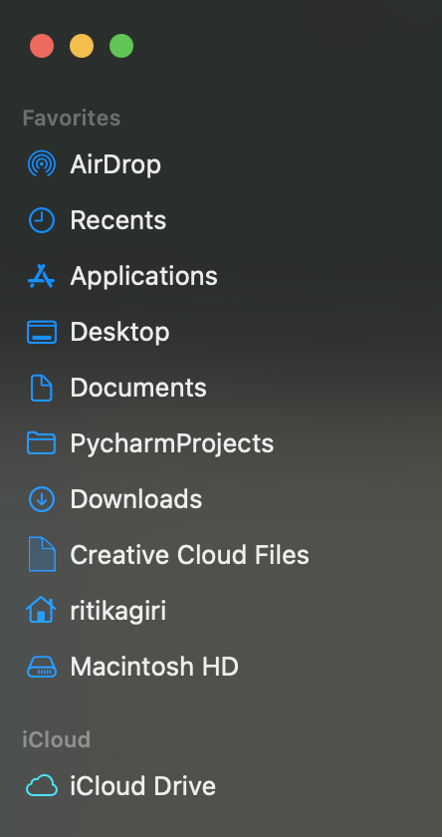
Home Directory

Slide 85
Home Directory: C:\Users\ritika = ~
c:
Program Files
~
Users
System
ritika
guest
Documents
Desktop
Music
Photos
dissertation
my_project
data.csv
process.py
DRAFT.docx

Slide 86
~/Documents/my_project/data.csv
c:
Program Files
Users
System
ritika
guest
Documents
Desktop
Music
Photos
dissertation
my_project
data.csv
process.py
DRAFT.docx

Slide 87
Working Directory
A directory in the filesystem associated with a running process or program
>> Where the computer starts when looking for files
>> Relative File Paths

Slide 88
Relative Path from Documents: my_project/data.csv
c:
Program Files
Users
System
ritika
guest
Documents
Desktop
Music
Photos
dissertation
my_project
data.csv
process.py
DRAFT.docx

Slide 89
From ritika:
c:
Program Files
Users
System
ritika
guest
Documents
Desktop
Music
Photos
dissertation
my_project
data.csv
process.py
DRAFT.docx
Notes:
Documents/my_project/data.csv

Slide 90
From ritika: Documents/my_project/data.csv
c:
Program Files
Users
System
ritika
guest
Documents
Desktop
Music
Photos
dissertation
my_project
data.csv
process.py
DRAFT.docx
Notes:
Documents/my_project/data.csv

Slide 91
.. means go up a level

Slide 92
From Desktop: ../Documents/my_project/data.csv
c:
Program Files
Users
System
ritika
guest
Documents
Desktop
Music
Photos
dissertation
my_project
data.csv
process.py
DRAFT.docx
Notes:
Documents/my_project/data.csv

Slide 93
From dissertation: ../Documents/my_project/data.csv
c:
Program Files
Users
System
ritika
guest
Documents
Desktop
Music
Photos
dissertation
my_project
data.csv
process.py
DRAFT.docx
Notes:
Documents/my_project/data.csv

Slide 94
From dissertation: ../my_project/data.csv
c:
Program Files
Users
System
ritika
guest
Documents
Desktop
Music
Photos
dissertation
my_project
data.csv
process.py
DRAFT.docx
Notes:
Documents/my_project/data.csv

Slide 95
But what is the Working Directory for R?
Default: home directory
RStudio Projects: the folder you associate with the project
>> You can set or change the working directory
Let’s go to R for a minute…

Slide 96
Why not just use absolute paths?

Slide 97
Store Project Files Together
project_directory
code
process_data.r
make_graphs.r
estimate_model.r
data
people.csv
exam1.csv
output
impact_plot.pdf
reports
chapter1.docx
working directory

Slide 98
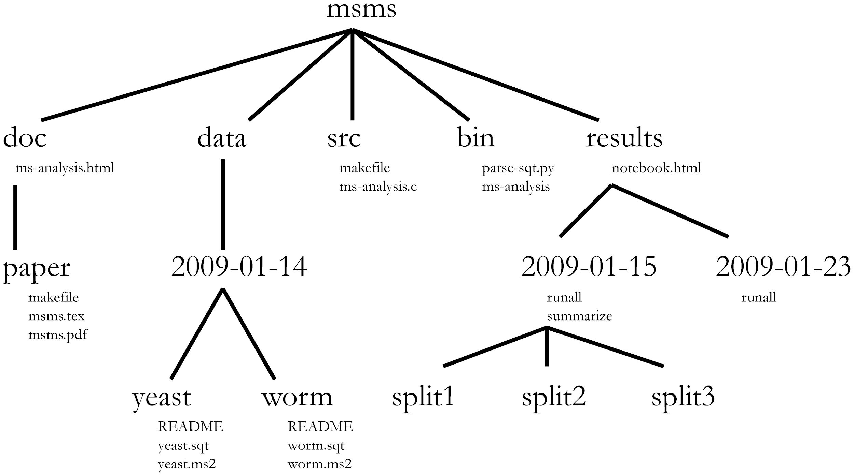
A Quick Guide to Organizing Computational Biology Projects
William Stafford Noble, Published: July 31, 2009,
https://doi.org/10.1371/journal.pcbi.1000424
A) msms/data/2009-01-14/yeast/yeast.sqt
B) ../data/2009-01-14/yeast/yeast.sqt
C) ~/data/2009-01-14/yeast/yeast.sqt

Slide 99

Back to RStudio…
Open script5.R

Slide 100
Working with Files
Reading and writing, Types

Slide 101

File Access Modes
Read: Open a file to get the contents
Write: Open a file, empty it!!!, and then write new data
Append: Open a file and write new data to the end of it

Slide 102
File Types
Text: Restricted set of characters >> Data can be opened and viewed directly
Binary: Custom data >> Needs a program to interpret and display the data

Slide 103
Plain Text Files
NO FORMATTING
NO IMAGES
Common extensions: .txt, .tab, .csv
Also plain text:
Data files: XML, JSON
Markup: HTML, Markdown (.md), LaTeX (.tex)
Code: R scripts (.r), Python scripts (.py)
Notes:
But it's not about the extension -- extension doesn't determine if a file is plain text

Slide 104
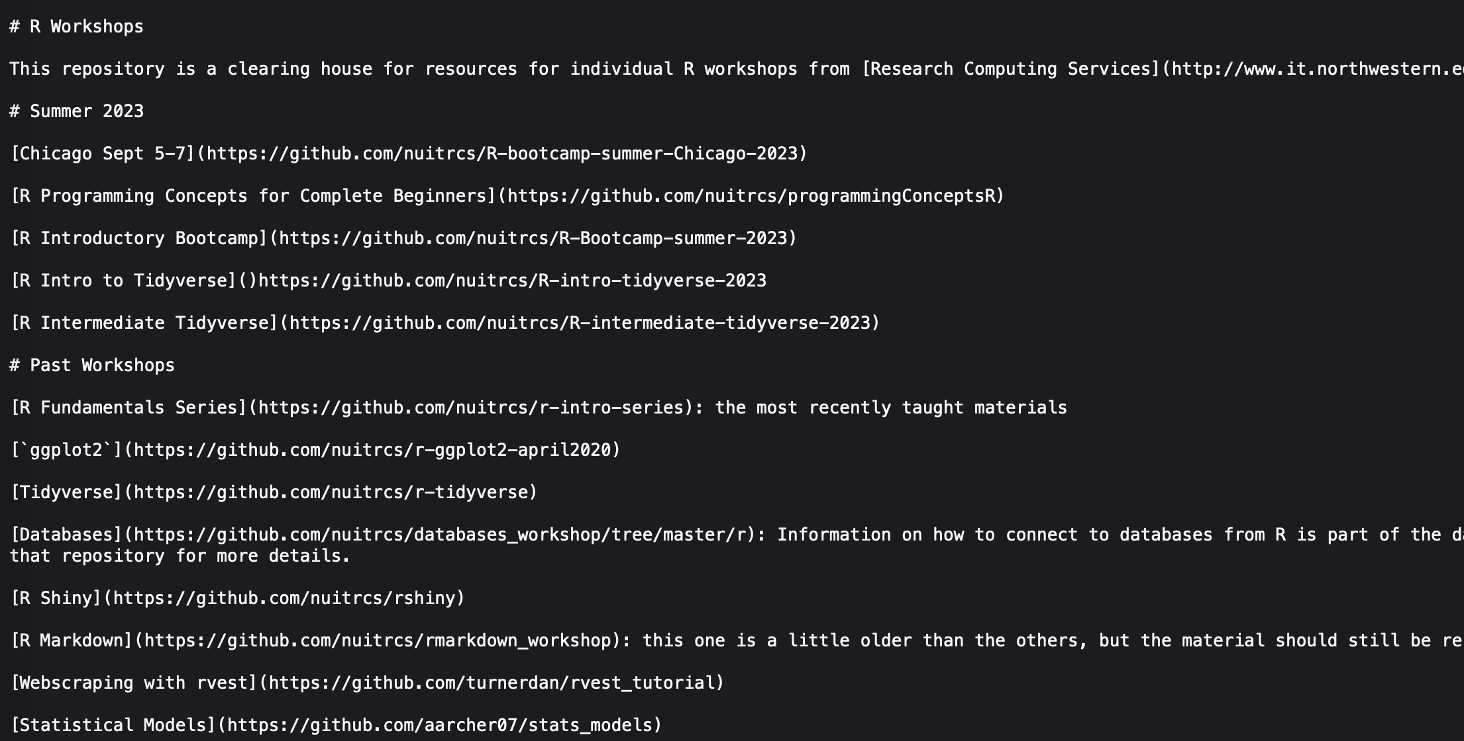
https://raw.githubusercontent.com/nuitrcs/rworkshops/master/README.md

Slide 105
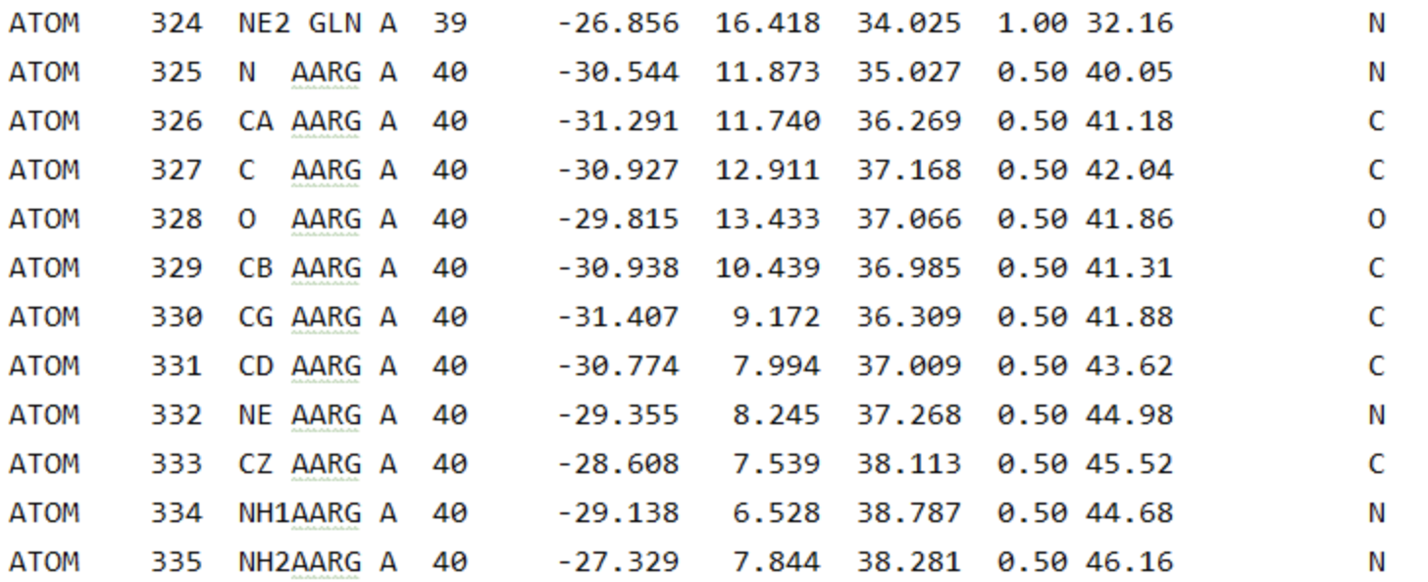
File: molecule.pdb

Slide 106
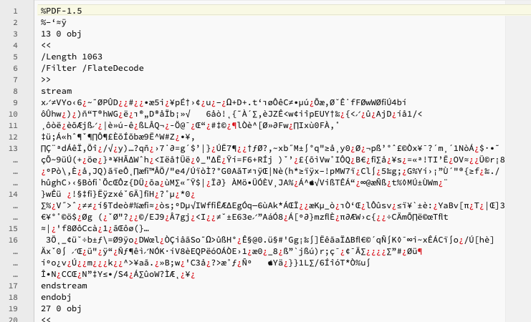

Slide 107
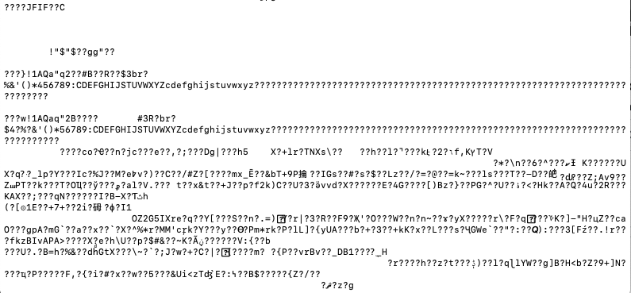

Slide 108
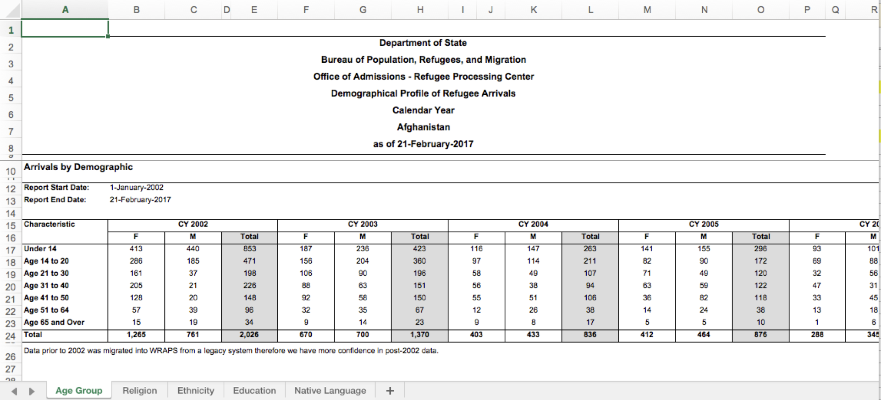
Is this a plain text file?

Slide 109
,,,,,,,,,,,,,,,,,,,,,,,,,,,,,,,,,,,,,,,,,,,,,,,,,,,,,
Department of State,,,,,,,,,,,,,,,,,,,,,,,,,,,,,,,,,,,,,,,,,,,,,,,,,,,,,
"Bureau of Population, Refugees, and Migration",,,,,,,,,,,,,,,,,,,,,,,,,,,,,,,,,,,,,,,,,,,,,,,,,,,,,
Office of Admissions - Refugee Processing Center,,,,,,,,,,,,,,,,,,,,,,,,,,,,,,,,,,,,,,,,,,,,,,,,,,,,,
Demographical Profile of Refugee Arrivals,,,,,,,,,,,,,,,,,,,,,,,,,,,,,,,,,,,,,,,,,,,,,,,,,,,,,
Calendar Year,,,,,,,,,,,,,,,,,,,,,,,,,,,,,,,,,,,,,,,,,,,,,,,,,,,,,
Afghanistan,,,,,,,,,,,,,,,,,,,,,,,,,,,,,,,,,,,,,,,,,,,,,,,,,,,,,
as of 21-February-2017,,,,,,,,,,,,,,,,,,,,,,,,,,,,,,,,,,,,,,,,,,,,,,,,,,,,,
,,,,,,,,,,,,,,,,,,,,,,,,,,,,,,,,,,,,,,,,,,,,,,,,,,,,,
Arrivals by Demographic,,,,,,,,,,,,,,,,,,,,,,,,,,,,,,,,,,,,,,,,,,,,,,,,,,,,,
,,,,,,,,,,,,,,,,,,,,,,,,,,,,,,,,,,,,,,,,,,,,,,,,,,,,,
Report Start Date:,1-January-2002,,,,,,,,,,,,,,,,,,,,,,,,,,,,,,,,,,,,,,,,,,,,,,,,,,,,
Report End Date:,21-February-2017,,,,,,,,,,,,,,,,,,,,,,,,,,,,,,,,,,,,,,,,,,,,,,,,,,,,
,,,,,,,,,,,,,,,,,,,,,,,,,,,,,,,,,,,,,,,,,,,,,,,,,,,,,
Characteristic,CY 2002,,,,CY 2003,,,CY 2004,,,,CY 2005,,,CY 2006,,,,CY 2007,,,CY 2008,,,CY 2009,,,CY 2010,,,CY 2011,,,CY 2012,,,CY 2013,,,CY 2014,,,CY 2015,,,CY 2016,,,CY 2017,,,Cumulative Total,%
,F ,M ,Total,,F ,M ,Total,F ,,M ,Total,F ,M ,Total,F ,,M ,Total,F ,M ,Total,F ,M ,Total,F ,M ,Total,F ,M ,Total,F ,M ,Total,F ,M ,Total,F ,M ,Total,F ,M ,Total,F ,M ,Total,F ,M ,Total,F ,M ,Total,,Total
Under 14,413,440,853,,187,236,423,116,,147,263,141,155,296,93,,101,194,65,55,120,78,85,163,55,51,106,75,78,153,44,61,105,83,96,179,84,106,190,102,100,202,145,190,335,464,447,911,54,76,130,"4,623",31.96%
Age 14 to 20,286,185,471,,156,204,360,97,,114,211,82,90,172,69,,88,157,34,55,89,63,66,129,29,43,72,48,68,116,47,38,85,56,79,135,63,92,155,97,87,184,120,197,317,311,385,696,36,58,94,"3,443",23.80%
Age 21 to 30,161,37,198,,106,90,196,58,,49,107,71,49,120,32,,56,88,39,24,63,50,42,92,24,32,56,45,67,112,46,37,83,41,48,89,66,64,130,82,52,134,119,91,210,303,277,580,39,25,64,"2,322",16.05%
Age 31 to 40,205,21,226,,88,63,151,56,,38,94,63,59,122,47,,31,78,34,26,60,47,42,89,31,26,57,35,38,73,30,32,62,50,43,93,57,37,94,51,27,78,82,61,143,225,138,363,29,23,52,"1,835",12.69%
Age 41 to 50,128,20,148,,92,58,150,55,,51,106,36,82,118,33,,45,78,20,23,43,38,53,91,15,22,37,24,17,41,23,12,35,31,21,52,35,28,63,35,30,65,64,41,105,124,97,221,17,12,29,"1,382",9.55%
Age 51 to 64,57,39,96,,32,35,67,12,,26,38,14,24,38,13,,18,31,12,18,30,15,27,42,3,5,8,13,15,28,11,6,17,12,13,25,16,19,35,10,15,25,28,18,46,65,45,110,9,7,16,652,4.51%
Age 65 and Over,15,19,34,,9,14,23,9,,8,17,5,5,10,1,,6,7,3,5,8,2,3,5,2,0,2,2,2,4,3,2,5,2,3,5,7,4,11,3,5,8,5,7,12,26,23,49,5,2,7,207,1.43%
Total,"1,265",761,"2,026",,670,700,"1,370",403,,433,836,412,464,876,288,,345,633,207,206,413,293,318,611,159,179,338,242,285,527,204,188,392,275,303,578,328,350,678,380,316,696,563,605,"1,168","1,518","1,412","2,930",189,203,392,"14,464",
,,,,,,,,,,,,,,,,,,,,,,,,,,,,,,,,,,,,,,,,,,,,,,,,,,,,,
Data prior to 2002 was migrated into WRAPS from a legacy system therefore we have more confidence in post-2002 data.,,,,,,,,,,,,,,,,,,,,,,,,,,,,,,,,,,,,,,,,,,,,,,,,,,,,,

Slide 110
Plain Text Editors
RStudio lets you write (or open) plain text files (so do other IDEs)
Stand alone options:
Mac: BBEdit
Windows: Notepad ++
Either: Sublime Text
Usually avoid built-in options: Notepad, TextEdit, WordPad

Slide 111

R Markdown/QuaRTo
Back to RStudio...

Slide 112
Data FRAMEs
Rectangles of Data

Slide 113

Rectangles of Data

Slide 114
Rows: Observations
Person (or mouse, worm, etc.)
Country
Year
Run/trial of an experiment
Chemical
Sample

Slide 115
Columns: Variables
Measurements
Grouping/identification variables:
> trial/sample
> condition
> label for the observation (country name)
Each ID variable in its own column

Slide 116
The $ operator
Access columns by names as:
data$column

Slide 117
Indexing
Access rows or columns by indexing as:
data [ rows , columns ]

Slide 118
Indexing : by POSITION
Provide the positions of the rows/cols you want:
data [ 1:10 , 2:5 ]
data [ , 2:5 ]
data [ 1:10 , ]
data [c(1,4) , c(3,5)]

Slide 119
Indexing : by POSITION
Provide the positions of the rows/cols you don’t want:
data [-1:-10, ]

Slide 120
Indexing : by NAME
Provide the names of the columns you want:
data [ , ”school” ]
data [ , c(”school”, “year”) ]

Slide 121
Indexing : by CONDITION
Filter rows by the conditions you want:
data[data$column == value, ]

Slide 122
Indexing : by CONDITION
Filter rows by the conditions you want:
data[data$column == value, ]
data[data$column > value, ]
data[data$column < value, ]

Slide 123
Indexing : by multiple CONDITIONs
Filter rows by combining conditions you want:
AND:
data[data$col1 >= x & data$col2 >= y , ]
OR:
data[data$col1 >= x | data$col2 >= y , ]
>=

Slide 124
Missing values NA
Missing values are represented by a special value NA
is.na(x) – returns TRUE or FALSE

Slide 125
Back to RStudio…
Open script6.R

Slide 126
Workflow
Organizing coding projects..

Slide 127



Data Analysis Workflow
Input file(s)
Output file(s)
Raw Data File
raw_data.csv
Cleaned Data
clean_data.csv
plot1.png
Cleaning script
cleaning.R
Analysis script
analysis.R
table.csv
plot2.png
Code script(s)

